Slide 1
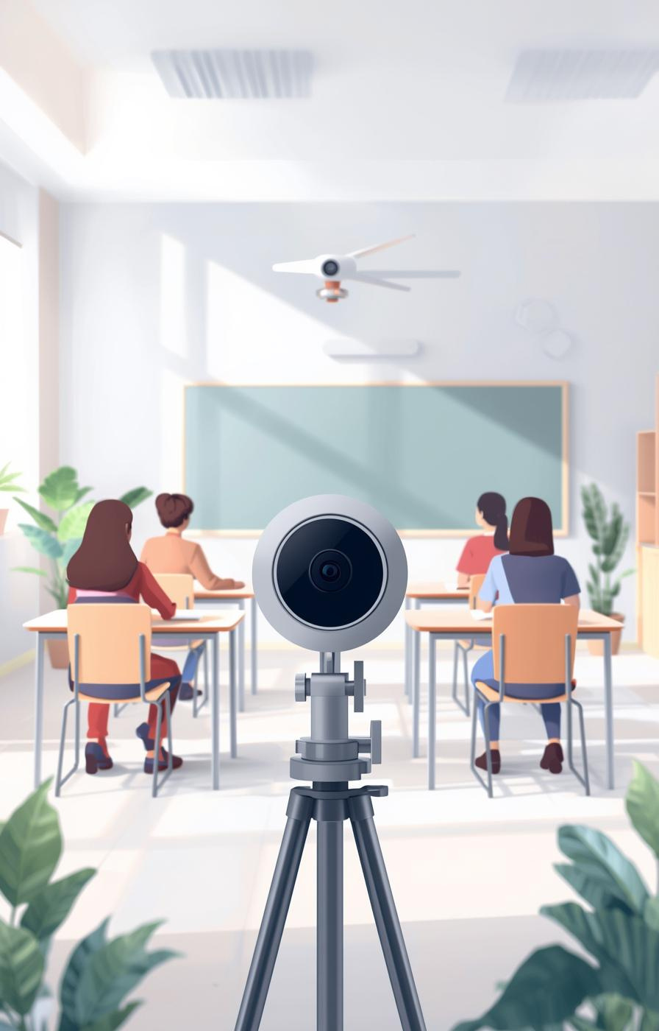

Face Attendance System
Presented by [Your Name]

Slide 2

What is Face Attendance?
Automated Attendance Tracking System Overview
The Face Attendance System utilizes live camera technology and advanced face matching algorithms to automate attendance tracking, ensuring accuracy and efficiency while significantly reducing manual efforts for instructors.
2

Slide 3

Live Camera Integration for Attendance System
Essential Component for Real-Time Tracking
Captures live images for attendance accuracy

Slide 4

Face Matching Process
The Face Matching Algorithm analyzes facial features captured by the camera, comparing them against stored images in the database to accurately determine identity, enabling efficient and automated attendance tracking.

Slide 5
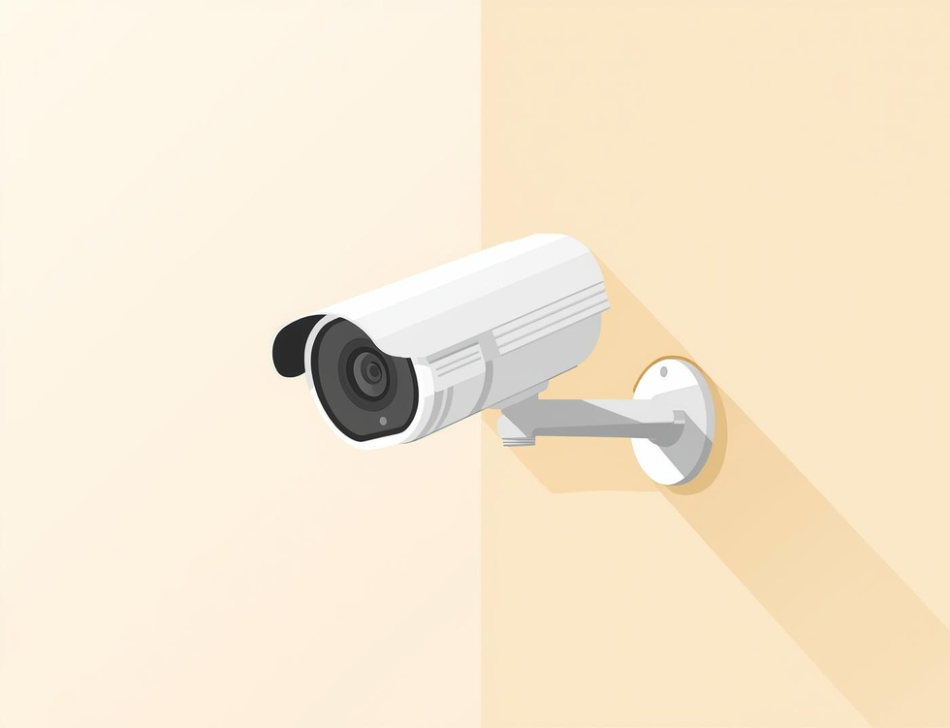
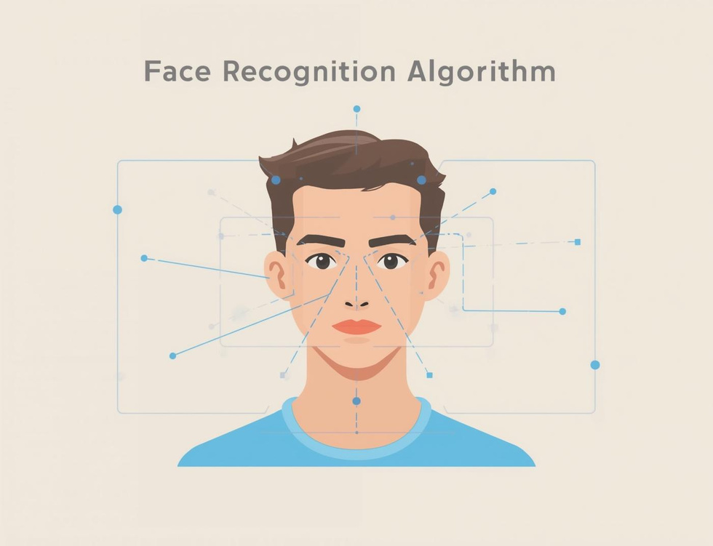

System Architecture
Camera
Face Matching
Attendance Database
The camera captures live video feeds for accurate attendance tracking in classrooms.
The algorithm processes captured images to verify identities quickly and efficiently.
The database stores attendance records securely, ensuring easy retrieval and management.

Slide 6
Key Features
Essential elements of the system
Real-time Attendance
Automated Reporting
User-friendly Interface
The system tracks attendance in real-time, ensuring that students are recorded accurately as they enter the classroom without any manual intervention, increasing efficiency significantly.
Attendance data is compiled into automated reports, providing instructors with comprehensive insights into attendance patterns and simplifying the administrative workload for efficient management.
The interface is designed to be intuitive and easy to navigate, ensuring that both students and instructors can use the system without any complex training requirements, enhancing overall user experience.
6

Slide 7



Implementation Steps
Capture Face
Match with Database
Record Attendance
The system uses a live camera to capture students' faces for identification.
Captured faces are matched against the database for accurate attendance records.
Attendance is recorded automatically, ensuring efficiency and accuracy in tracking presence.

Slide 8


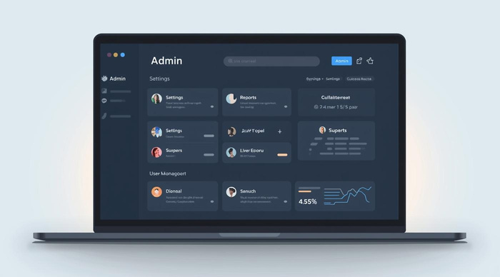
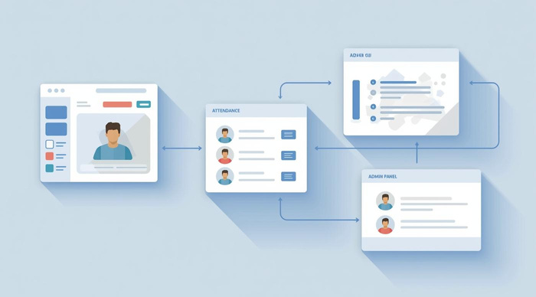
GUI Components of the Face Attendance System
Camera View
Attendance List
Displays real-time footage for monitoring attendance.
Shows registered students with their attendance status.
Admin Panel
User Management
Central interface for managing system operations.
Allows adding or removing users easily.

Slide 9

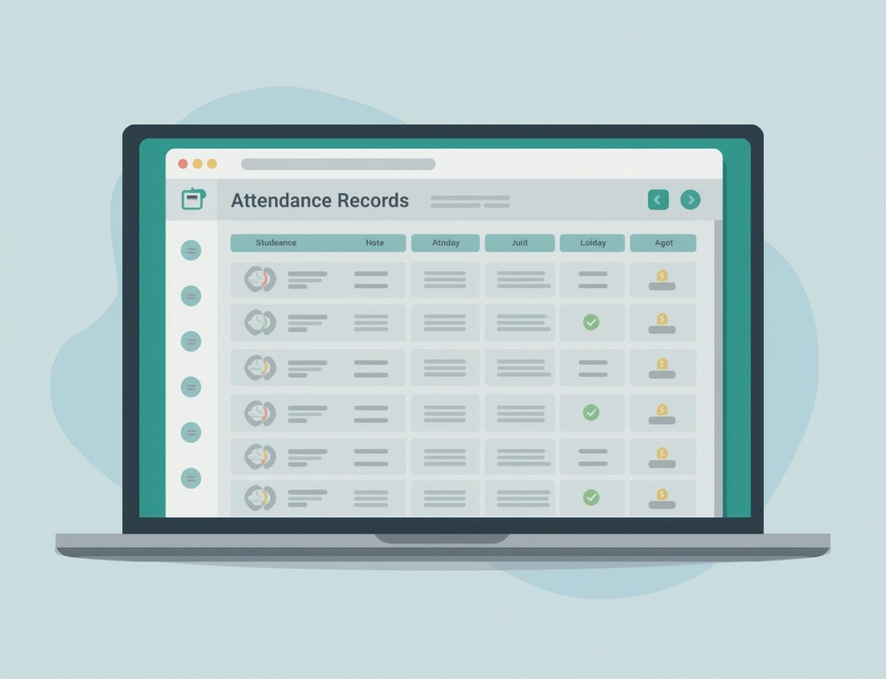
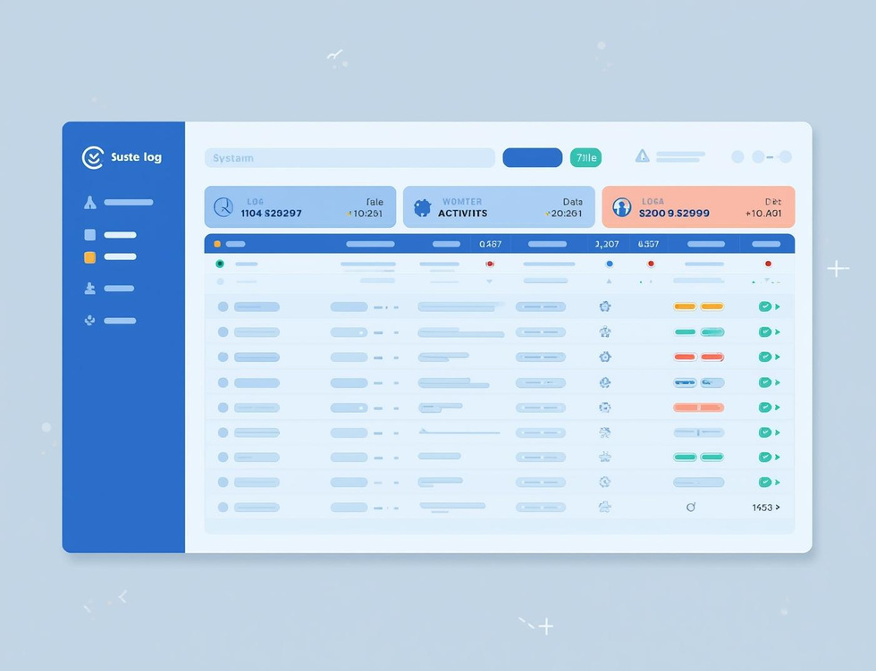
Database Design
Student details
Attendance records
System logs
The system stores essential student information for efficient attendance tracking and management.
Attendance records are updated in real-time to provide accurate tracking of student presence.
System logs maintain a history of actions taken for security and auditing purposes.

Slide 10



Security Measures
Encryption
Access Control
Audit Trails
Ensures all personal data remains safe and protected from unauthorized access at all times.
Manages who can view or modify data, ensuring only authorized personnel can access sensitive information.
Tracks all system activities, providing a detailed record of who accessed what and when for accountability.

Slide 11
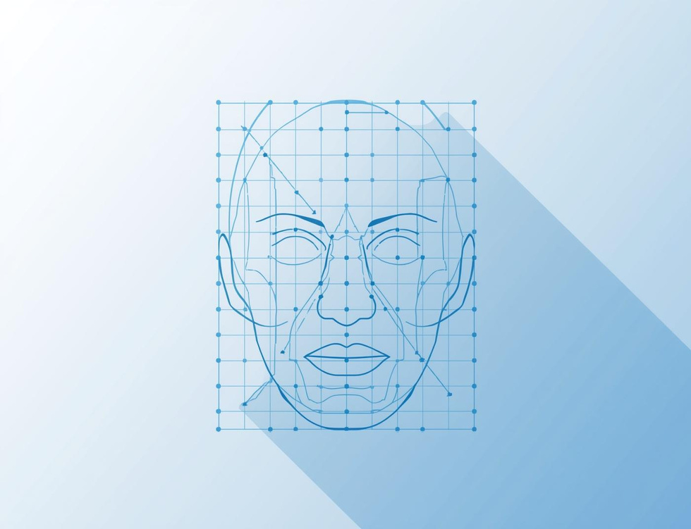


Accuracy and Performance
Face Detection Rate
Processing Speed
Data Reliability
The system achieves a high detection rate, ensuring accurate identification of individuals.
With optimized algorithms, the system processes images swiftly, allowing for real-time attendance tracking.
The system ensures consistent data reliability, providing accurate attendance records for all users.

Slide 12
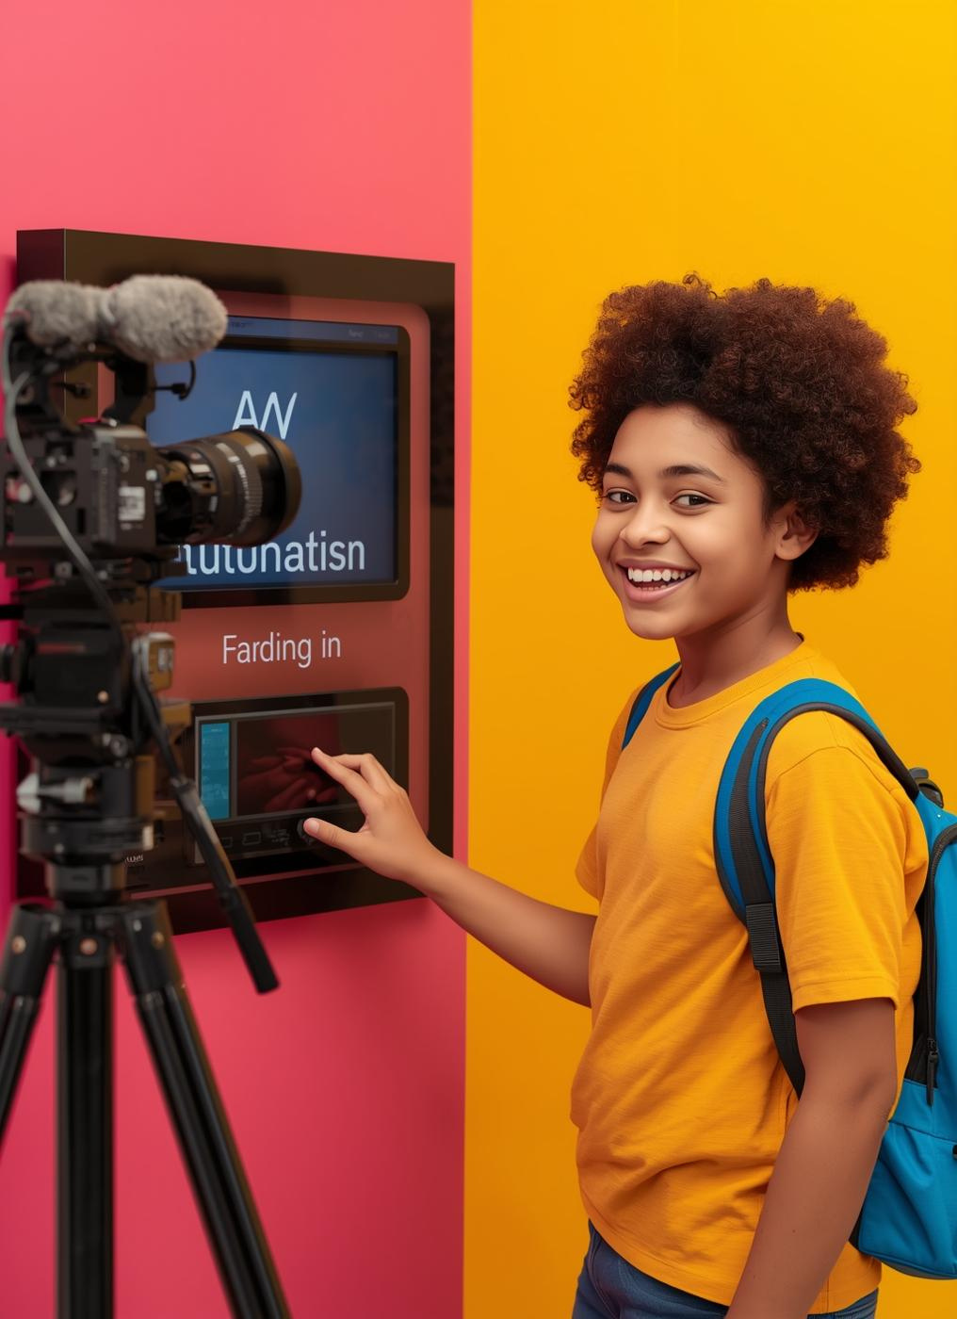
Benefits for Students
The Face Attendance System simplifies the check-in process, ensuring hassle-free attendance without manual entry. Students receive instant notifications, enhancing engagement and streamlining communication with instructors and peers.

Slide 13



Benefits for Instructors
Automated Reports
Time Savings
Reduced Errors
Instructors receive instant reports on attendance, improving tracking and management efficiency.
The system significantly reduces manual entry time, allowing instructors to focus on teaching.
Automated processes minimize human errors, enhancing overall accuracy in attendance records.

Slide 14




Future Enhancements for Attendance System
Multi-location
Cloud integration
Supports attendance tracking across various sites.
Enables remote access and data synchronization.
Mobile app
Enhanced user experience
Offers convenience for user attendance tracking.
Provides an intuitive interface for all users.

Slide 15



Flow Diagram
Camera Input
Face Detection
Attendance Record
The system captures live video feed for real-time analysis and processing.
Advanced algorithms identify and verify faces within the captured video stream.
Detected faces are logged into the attendance database for accurate tracking and reporting.

Slide 16

Classroom Attendance Innovation
The Face Attendance System provides efficient attendance tracking in classrooms, enhancing the learning experience by automating check-ins. This technology empowers both instructors and students through seamless integration and user-friendly interfaces.

Slide 17


Summary
Key features of the system

